Slide 1
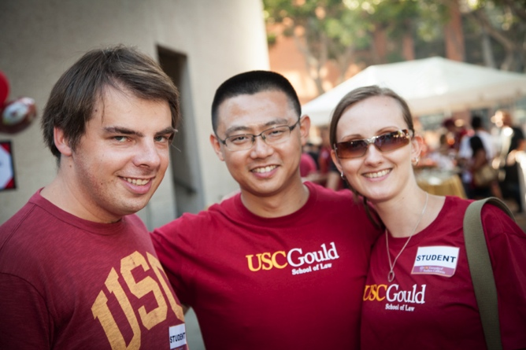

USC Gould Globalized
  USC Gould School of Law is now one of the largest of the top law schools in graduate/international student enrollments
  11 graduate/international law programs
  291 students enrolled in current 2013-14 academic year

Slide 2

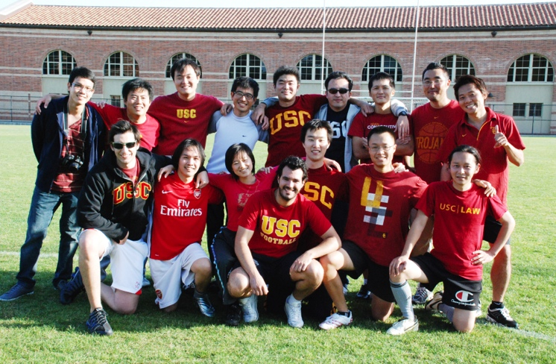

Current Program Offerings
Master of Laws (LL.M.)
Master of Comparative Law (M.C.L.)
Business Law Certificate
Entertainment Law Certificate
Summer Law & English Program
Visiting International Program for Lawyers
Study Abroad Exchange
  University of Hong Kong
  Bocconi University
  Bond University
  Fundação Getúlio Vargas University
  University Jean Moulin Lyon III

Slide 3
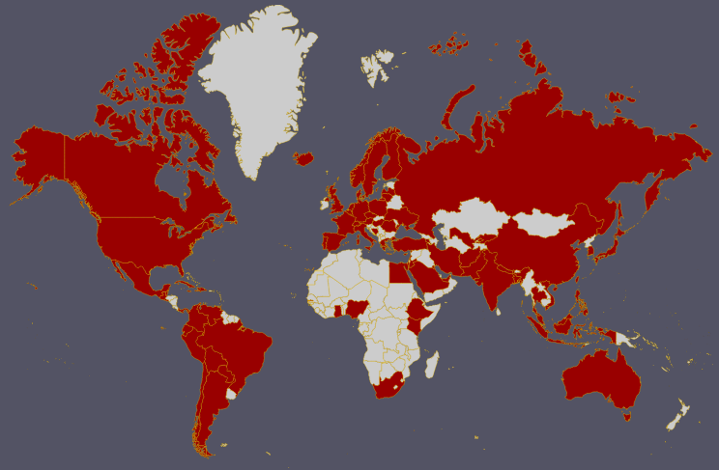
USC Gould & The World
1,253 alumni from 67 countries worldwide
Notes:
World map with alumni countries designated in red

Slide 4
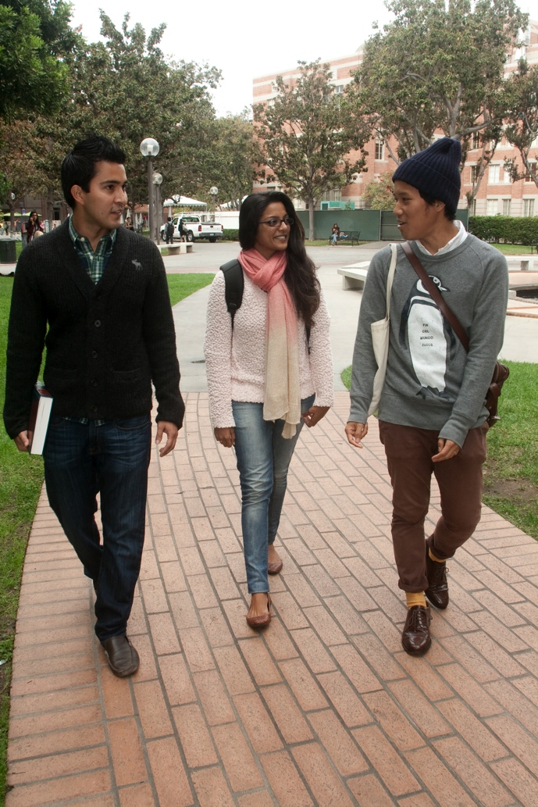
The Road Ahead
Expansion of existing programs
Launch of new graduate/international programs
  Online LLM Program
  Online Certificate Programs
  Residential Certificate Programs
  Summer Programs
  Non-lawyer Programs
Maintain/improve our quality measures & rigorous admission standards across all programs

Slide 5
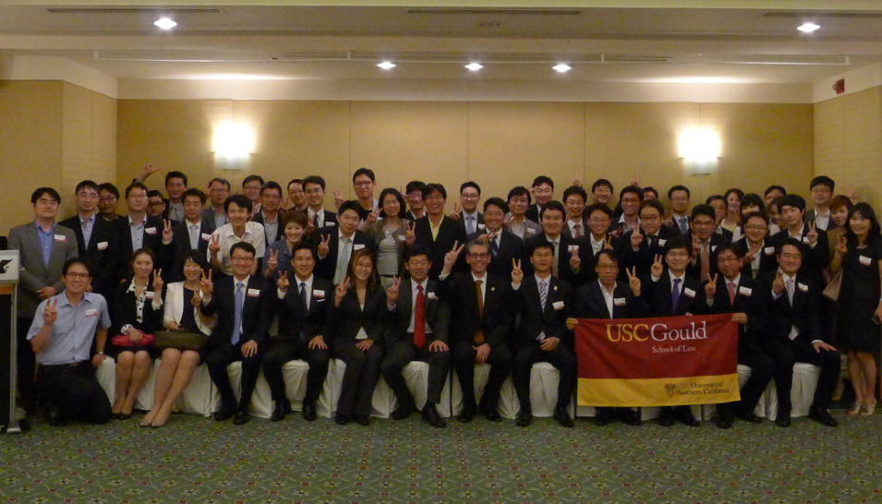
Lessons Learned
Maintain contact with key constituents
  Communication is critical
  Listen to partners, students & the market
Keep an eye on the competition
  Be nimble & ready to react
Evaluate & assess recruiting plans
  Budget management & careful planning essential
International education partners
  Not always explicit about their wants, needs and issues

