Slide 1


World Bachelor’s in Business:
A partnership of
Notes:
Reflects each school’s commitment to be an innovator and leader in global education and to anticipate emerging trends.

Slide 2

Motivating Factors:
Complement (vs. Compete with) Existing Programs
Freshman: * Global Leadership Program (GLP); * Learning About International Commerce (LINC)
Junior
* International Exchange
* ExCel
* Global Business Brigades
* Transfer International Experience (TIE)
Senior
* ExCel
* Global Business Brigades
Sophomore
* ExCel
* Global Business Brigades
* Glocal Class
International
Internships
International
Internships
International
Internships

Slide 3

New Concept: Motivating Factors
Student: Provide an unparalleled global student experience and set of degrees
Marketplace: Address marketplace demands for global talent
Institutional:
  Understand how to develop and maintain successful global partnerships
  Positions the school and its partners as innovators and leaders in global higher education
  Attracts top student talent, even if students do not enroll in the WBB
  Creates potential for deeper partner relationships

Slide 4
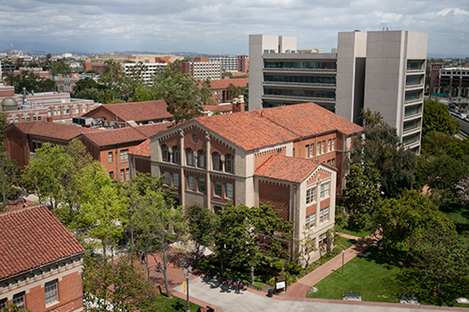

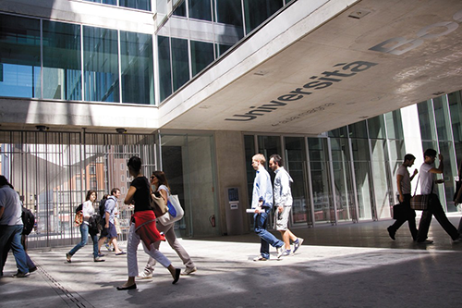
World Bachelor in Business (WBB) Concept
New undergraduate degree program
3 top business schools in major economic zones of the world
  Los Angeles + Hong Kong + Milan
Students
  concurrently admitted to all 3 universities
  concurrently enrolled in all 3 universities
  receive degrees from all 3 universities
  study and live in three of the world’s most dynamic cities

Slide 5

WBB Overview: Mechanics
Prolonged time in residence (1 year at each school) allows immersion and experience in the three major economic/cultural regions of the world:
Cohorted
All instruction is in English
Full business curriculum that fulfills the degree requirements of each school (no new program-specific courses added)
Tuition
Articulation agreements
First cohort of 45 students started in Fall of 2013

Slide 6



WBB Overview: Process
Year 1 in LA at USC
Year 2 in Hong Kong
at HKUST
Year 3 in Milan at Bocconi University
Year 4 students choose

Slide 7
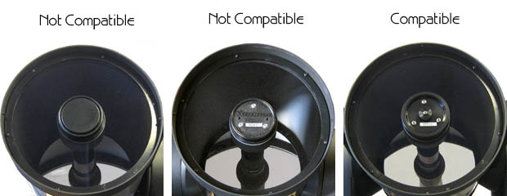
Lessons Learned
Find the Right Partners: Compatibility is Key
  Similar in program stature
  Common values and goals
  Compatible curriculum
  Common understanding of desired student experience
  Agreement on the type of student who will do well
  Willingness to be innovative and to compromise on policies and procedures

Slide 8

Lessons Learned
Start with Agreed Upon Principles:
  Students are not USC or HKUST or Bocconi students; they are WBB students
  Won’t give up on academic standards
  Won’t give up on admissions rights
  Money should not impact where students spend their final year
  Need a program director and academic advisor at each school
  Need scholarship support

Slide 9

Lessons Learned
Gain Commitment (fragile process)
  From partners
  From the top (e.g., Dean, Provost, other key administrators)
  From external stakeholders (e.g., prospective employers)
  From internal stakeholders (program implementation)
  From prospective students

Slide 10

Lessons Learned
Act Methodically and in a Collaborative Manner
  Include others early to understand what is critical from decision makers or stakeholders
  Develop levels of cross-partner communications (e.g., admissions with admissions) different things will come up at different levels
  Build in time for developing personal relationships with can foster trust and a common sense of purpose
But Have a Sense of Urgency
    Work toward a solid launch deadline

Slide 11

Lessons Learned
Expect the Unexpected
  What’s important for you may or may not be important to your partner; Partners may have different entities to whom they are responsible
  Examples….
    Amount of time on campus
    Admissions cycle
    Specific curriculum requirements
    Branding/marketing communications
Don’t Underestimate cultural differences
  Examples- college application/acculturation process
Things will go wrong (or change)- requires continuous adaptation

