Slide 1

Global Annenberg
Provost Faculty Senate Retreat
February 2014

Slide 2
Becoming Global
Long history of international programs—over 40 years
Global strategy developed about 15 years ago
  Increase number of students who have an international experience
  Need to bring an explicit global perspective to teaching and research

Slide 3
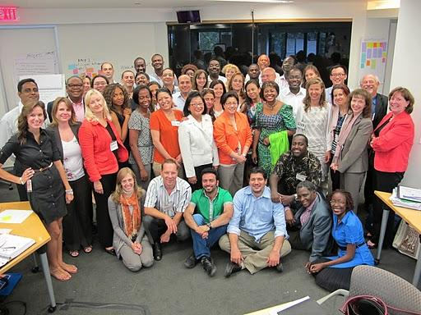
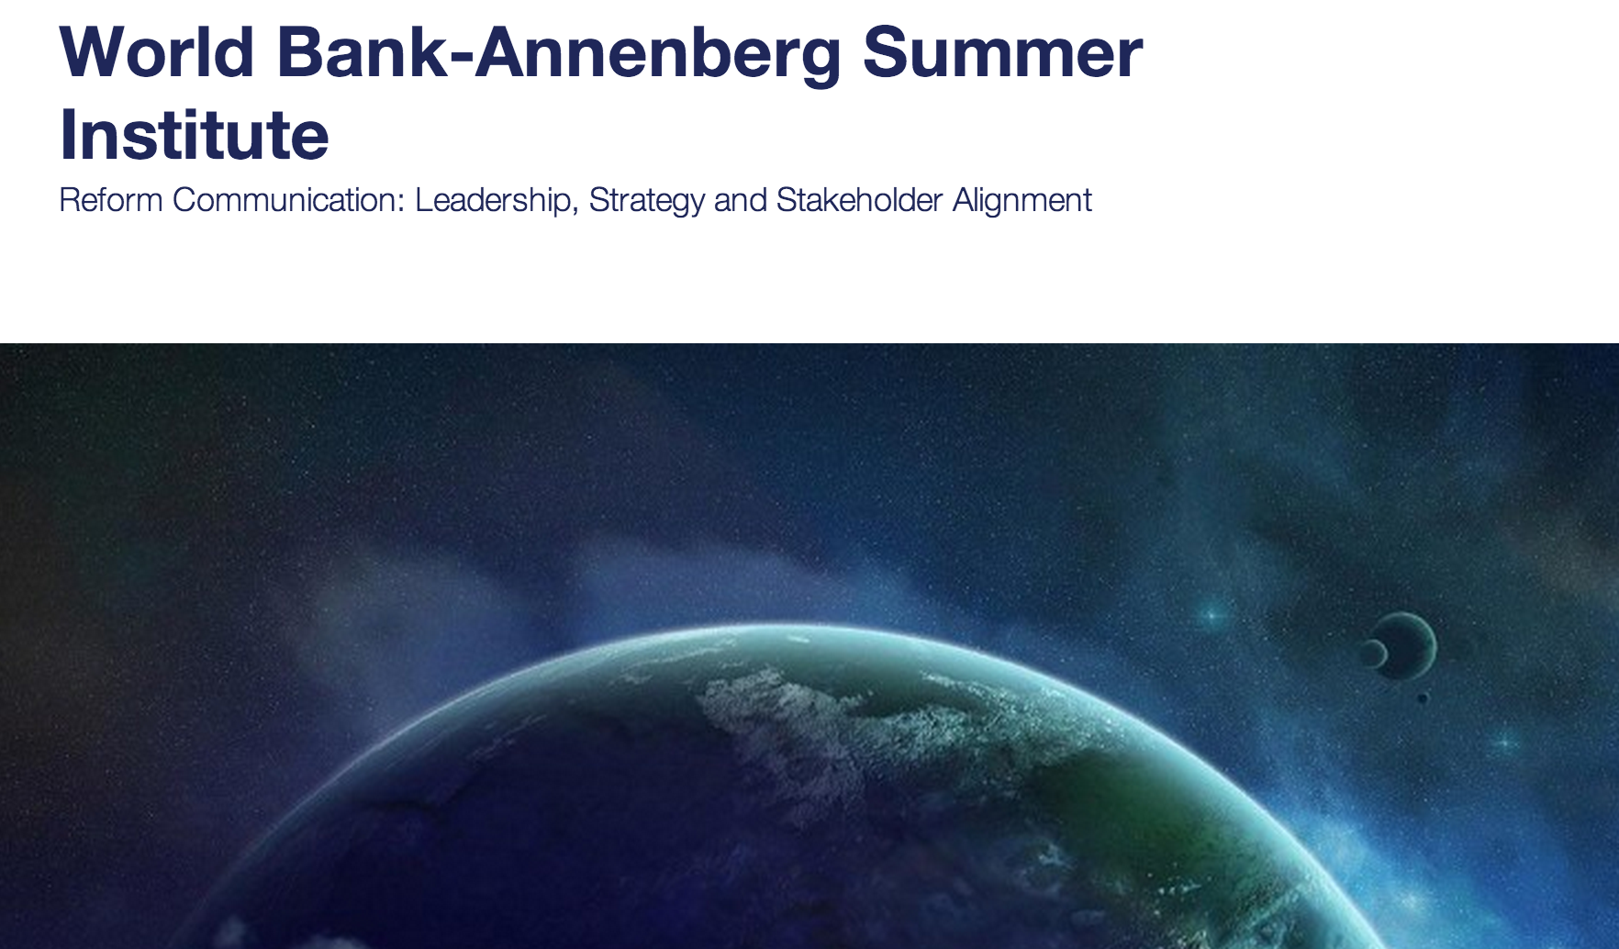
International Partners:
Study Abroad Programs
  Semester programs
  Summer programs
  Both graduate and undergraduate
Undergraduate Student Exchanges and Visiting Graduate Students and Scholars
University Partnerships
  Elite institutions

Slide 4

Bring the World to USC
Executive Education Programs with IGOs/NGOs
  Summer Institute in Public Diplomacy
  World Bank/Annenberg Schools Summer Institute on Reform Communication and Governance
Corporations
  E.g., Shanghai Media Group
Notes:
World map with alumni countries designated in red

Slide 5
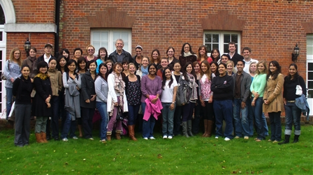
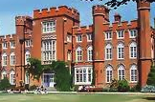
Dual Degree with the LSE in Global Communication
University Partnerships
  Elite institutions
Oldest international dual degree program at both USC and the LSE
Amazing students
Partnership deepened both teaching and research
Over 500 alumni

Slide 6
Lessons and Challenges
Information sharing is critical
  Contracts and MOUs are not enough—need great collaborators and explicit day-to-day process agreements
Turnover is particularly difficult—requires retraining
  Different calendars, different letters
Scholarships—peanut butter approach to fill seats

Slide 7
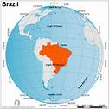
The Future
Continue to grow current programs—all students should have an international experience
New graduate/international programs
  Online program with the World Bank
  Additional summer certificate programs for students focusing on the Global South (e.g., Brazil)
More contact with alums in other countries—especially China
More research partnerships

