Slide 1
Provost – Academic Senate Retreat
Cultural Challenges in Educating Global Students: Learning, Acculturation, Integrity
Kelly Goulis
Senior Associate Dean
Viterbi School of Engineering

Slide 2
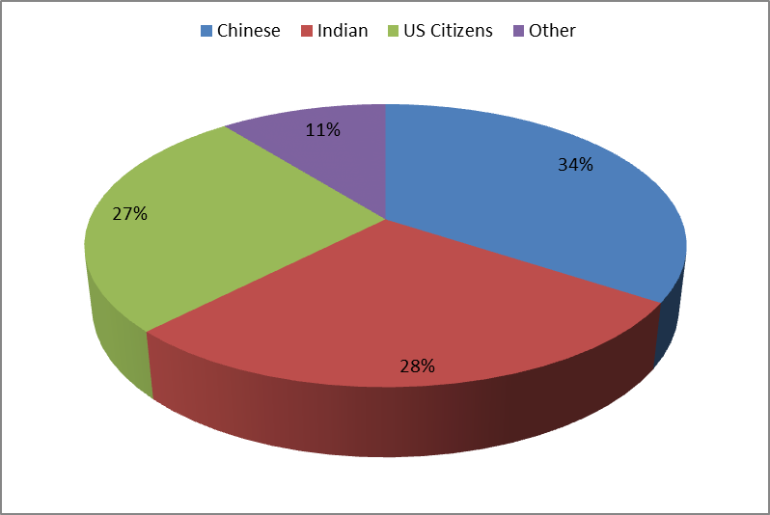
Snapshot: Viterbi School of Engineering Master’s Students
3,894 Viterbi Master’s Students
59 different countries
62% are Chinese or Indian
Of the US citizens, 39% are enrolled on campus (69% are enrolled online - DEN@Viterbi)
New students attach to existing USC Chinese and Indian communities before arriving on campus
Students typically graduate in 3 -4 semesters
11% from “other” countries often lack the benefits associated with the strong ethnic communities and can feel isolated

Slide 3
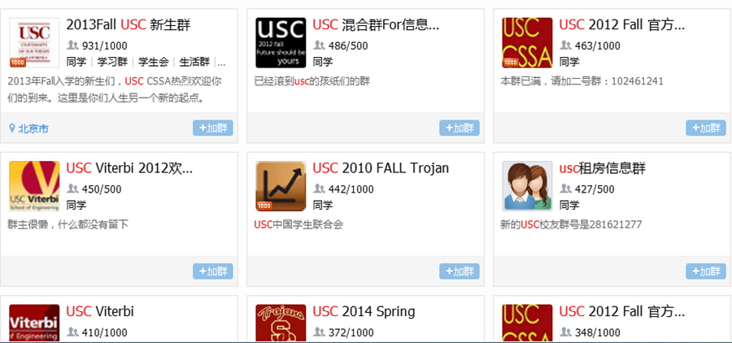
Cultural Cliques Focus Group: Chinese Students
Students begin to connect with their own cultural groups from the moment they decide to apply
China: QQ groups (online messenger software used frequently in China)
A search of USC on QQ groups the groups are by School/Apply Year/Admitted Year etc.
These groups are formed by volunteers (typically current students or alumni) and then promoted through online forums and word of mouth

Slide 4
Cultural Cliques Focus Group: Chinese Students
Perceived Benefits:
Reliable resource where students can exchange information - from application process, travel information, carpool, all the way to housing, roommate matchups and course selections
Helps build connections and relationships before arriving to USC
No language barriers, easy to communicate
Mitigates homesick or loneliness
Note: For many of these students, this is their first time away from their country or town
Challenges:
Makes it too easy for students to stay in the comfort zone of their own community, not fully integrating with all USC Communities
Students tend to follow the same studying, job-hunting, living patterns of other ethnic group members
Students tend to pick classes with a TA of their own origin.
They believe they “will be graded in favor due to the same-ethic-group affection.”

Slide 5
MS Student Survey – Student Programing:
Notes:
Most strongly agree:
Increase ability to learn on your own
Increase ability to be flexible & adapt to changing circumstances
Develop independence/self reliance
Closely followed by
Develop skills that will allow me to earn a high income
Develop a better way of communicating your ideas
Other goals:
Become happy, & more motivated
English communication
Challenge myself intellectually & morally
Increase self confidence
Learn the American way/American dream

Slide 6
Programming of Interest to All Viterbi MS Student Opportunities to Address Cultural Cliques
1. Career Goals (86%) | 6 Other:
2. Social Activities (80%) | a. Industry Information
3. Getting Involved on Campus (74%) | b. Speed dating
4. Academics (72%) | c. Interdepartmental Activities
5. Sports / Physical Health (57%) | d. Student work showcase
Redirected the Viterbi Graduate Student Association (VGSA) to work closely with my office in developing activities and programming of broad appeal
Step 1: Ensure VGSA is a fair representation of our entire graduate student body (historically, predominately Indian)
Worked with them to rewrite their constitution
Instituted popular elections for all senators
Instituted terms for all positions
Step 2: Develop programming of appeal to a broad group of students
*Survey question was multiple choice with these options listed. Open ended answers listed under “other.”

Slide 7
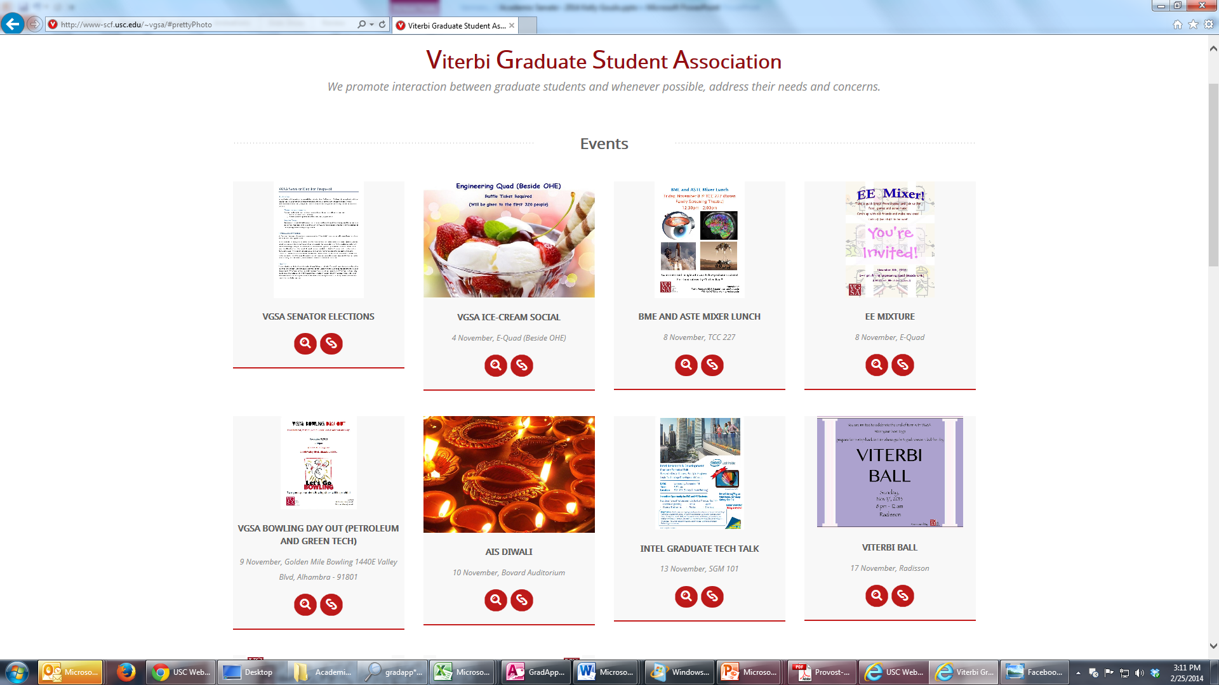

Slide 8
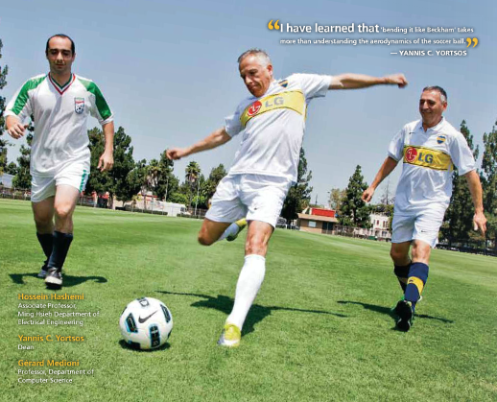
VGSA Soccer Cup!

Slide 9
Academic Integrity: VSoE
Last Year: 58% of the violations at USC were reported by VSoE
VSoE Task Force led by Steve Bucher
Surveyed faculty and students
Meetings with various faculty
Focus Groups

Slide 10
Faculty Survey 300 VSoE Faculty Surveyed: 119 Responses
42% Agree / Strongly Agree that cheating is widespread among VSoE MS Students
Recurring Comments:
Reporting cheating is too much work
International students tend to be the violators
Electronic age makes it too easy to cheat
Tougher policy is needed
Worried about the impact on teaching evaluations
Concerned a harsh sanction will ruin a student’s academic career
New Reporting System: Includes Sanction Options
Reporting has increased 4 times since the online system was implemented

Slide 11
Student Survey 3,300 VSoE MS Student Surveyed: 323 Responses
92%: Academic integrity rules are made sufficiently clear
19%: Strongly Agree / Agree that cheating is widespread among VSoE M.S. courses
39%: Have seen someone cheat
28%: Believe cultural differences can lead to an inaccurate understanding of the academic integrity policy at USC
Comments:
“Get bigger classrooms for exams ….”
“Never use material from the previous year”
“Make their own assignments such that students cannot find solutions on the internet”
“Have clear policies on the penalties and enforce them. By this stage, everyone knows about academic integrity. They just need to be reminded on the harsh penalties of cheating”
“Clarity in the tasks where collaboration is allowed versus where it is not “
“Highlight the importance of it in the engineering profession”
“Graders look out for students of their own nationality”

Slide 12
“When students are in a foreign country, it is natural for them to always look for “tips” and “tricks” first when running into issues or choice-making. This is when academic integrity challenges happen.
Because they are all so relying on their own ethnic groups that each other’s life would cross path so much, it is hard for one to reject another’s request of favor in facilitating an academic integrity violator.
Viterbi MS Student from China

