Slide 1
The Global USC I’d like to see
David C. Kang
USC Provost’s Retreat
February 28, 2014

Slide 2
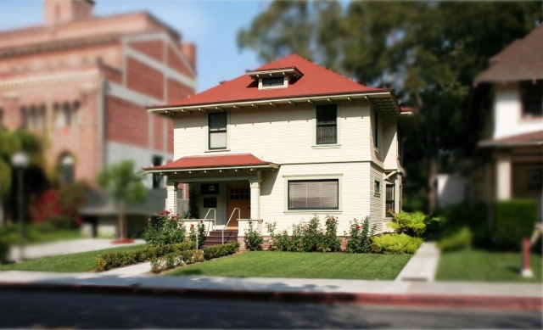
USC Korean Studies Institute, established 2005

Slide 3
Reaching out to the discipline
Making USC a center for Asian studies

Slide 5
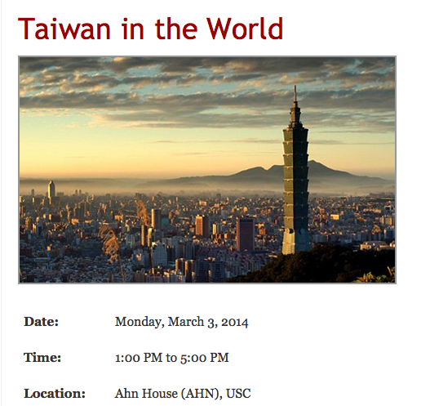

Slide 6
KSI Manuscript reviews
Creating a community of mentoring and collaboration

Slide 7
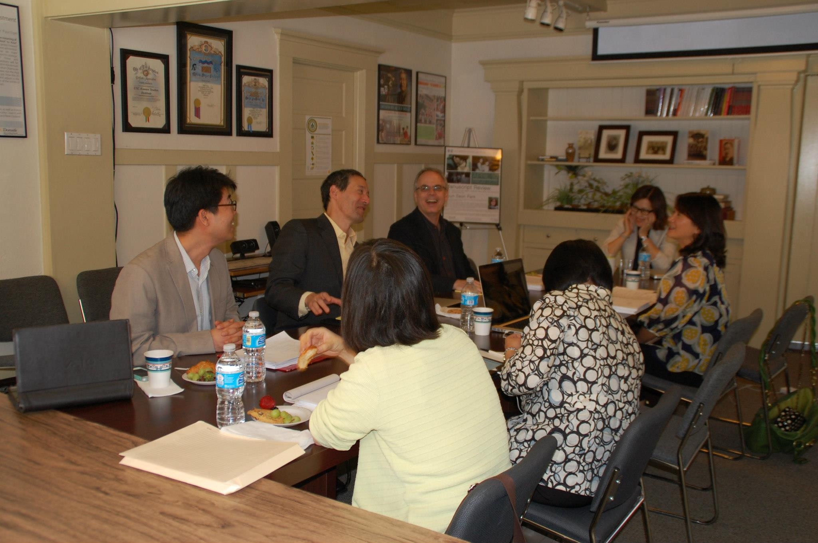

Slide 8
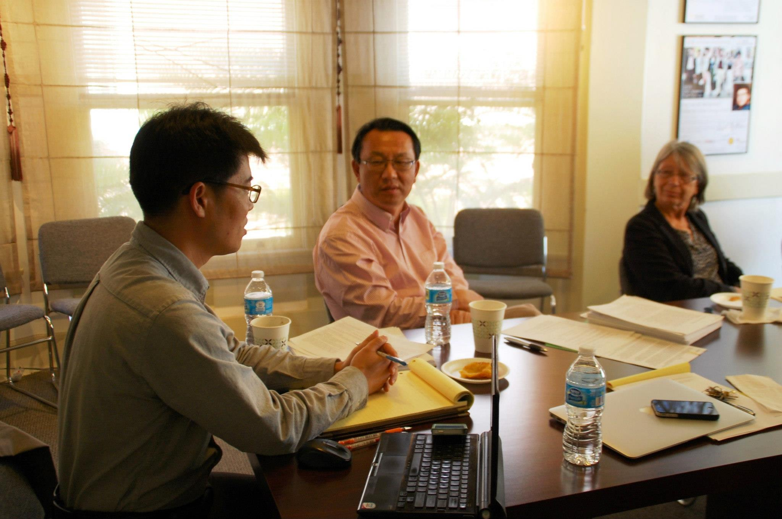

Slide 9
KSI graduate conference
Professionalization begins early

Slide 11
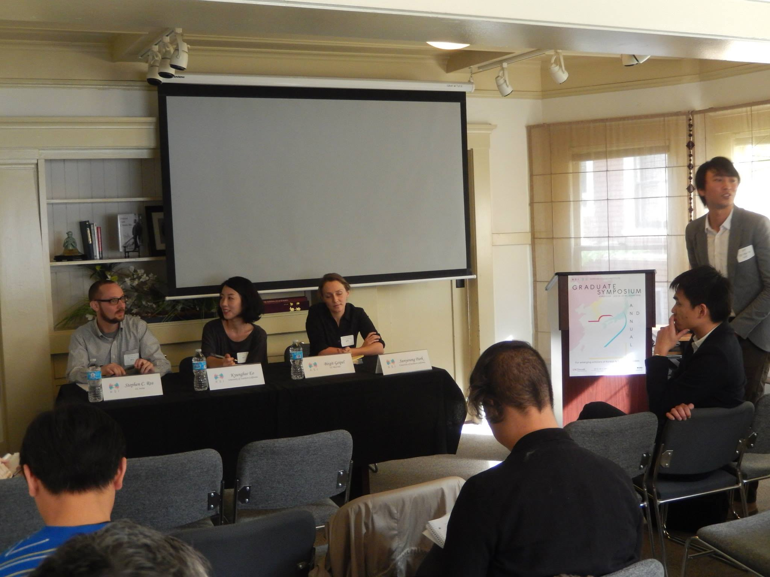

Slide 12
KSI Fellows
Enriching the undergraduate experience

Slide 13
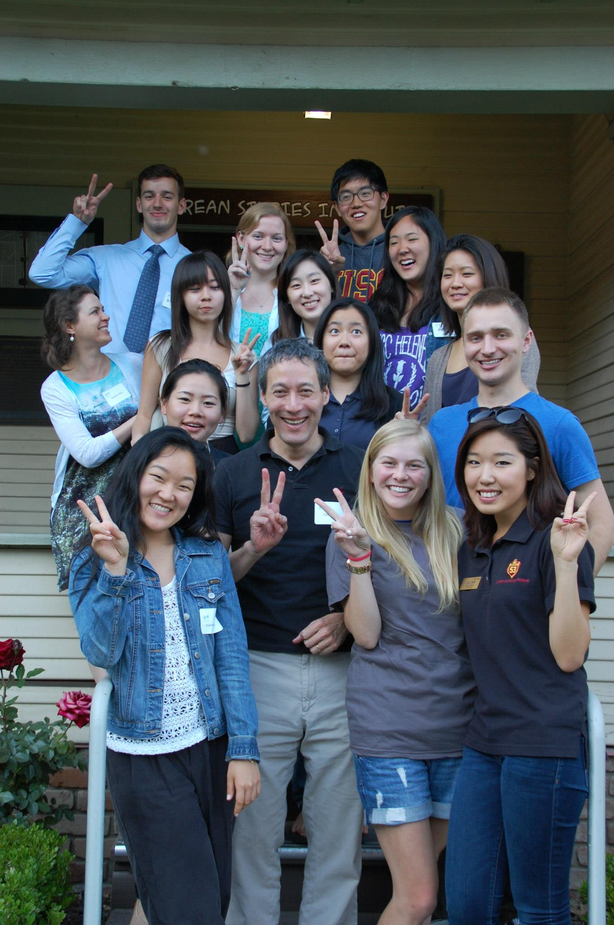

Slide 14
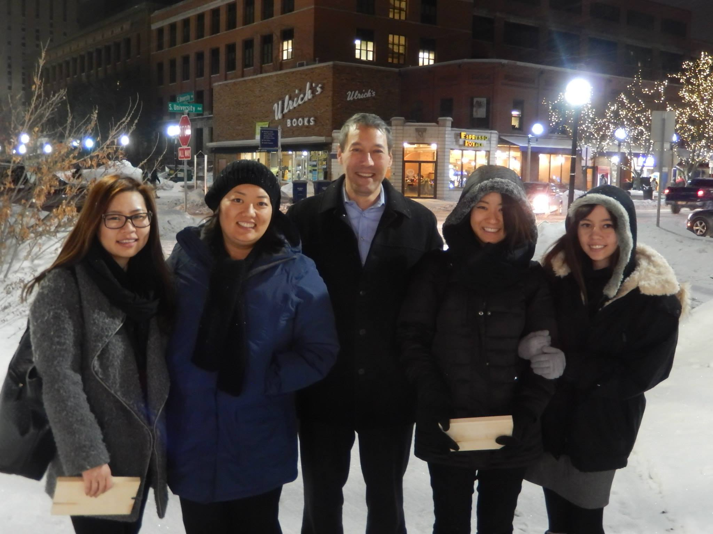

Slide 16
KSI YouTube video series
Linking USC with the general public

Slide 17
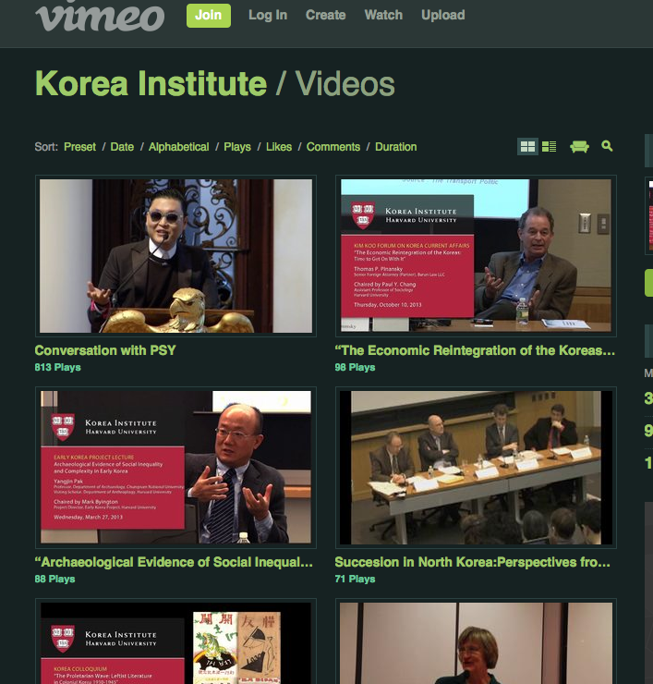

Slide 19
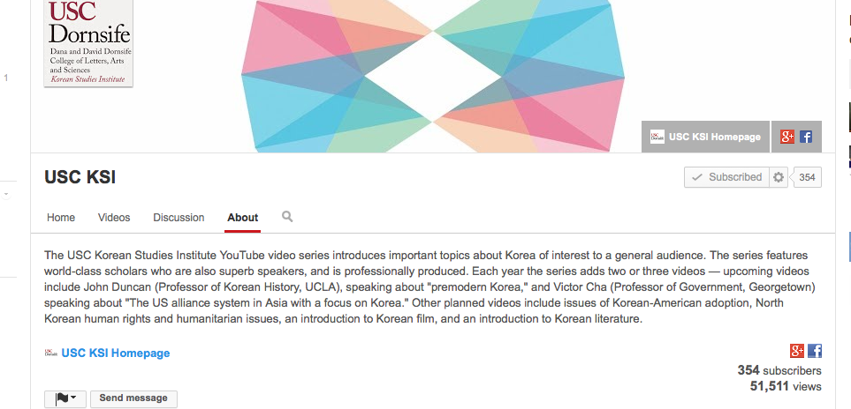

Slide 20
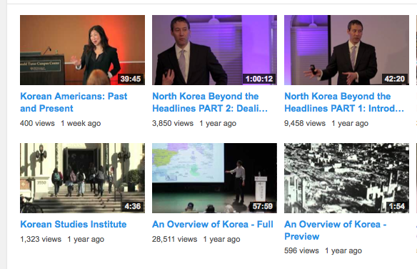

Slide 21
K-12 teacher education
Linking to the wider community

Slide 22
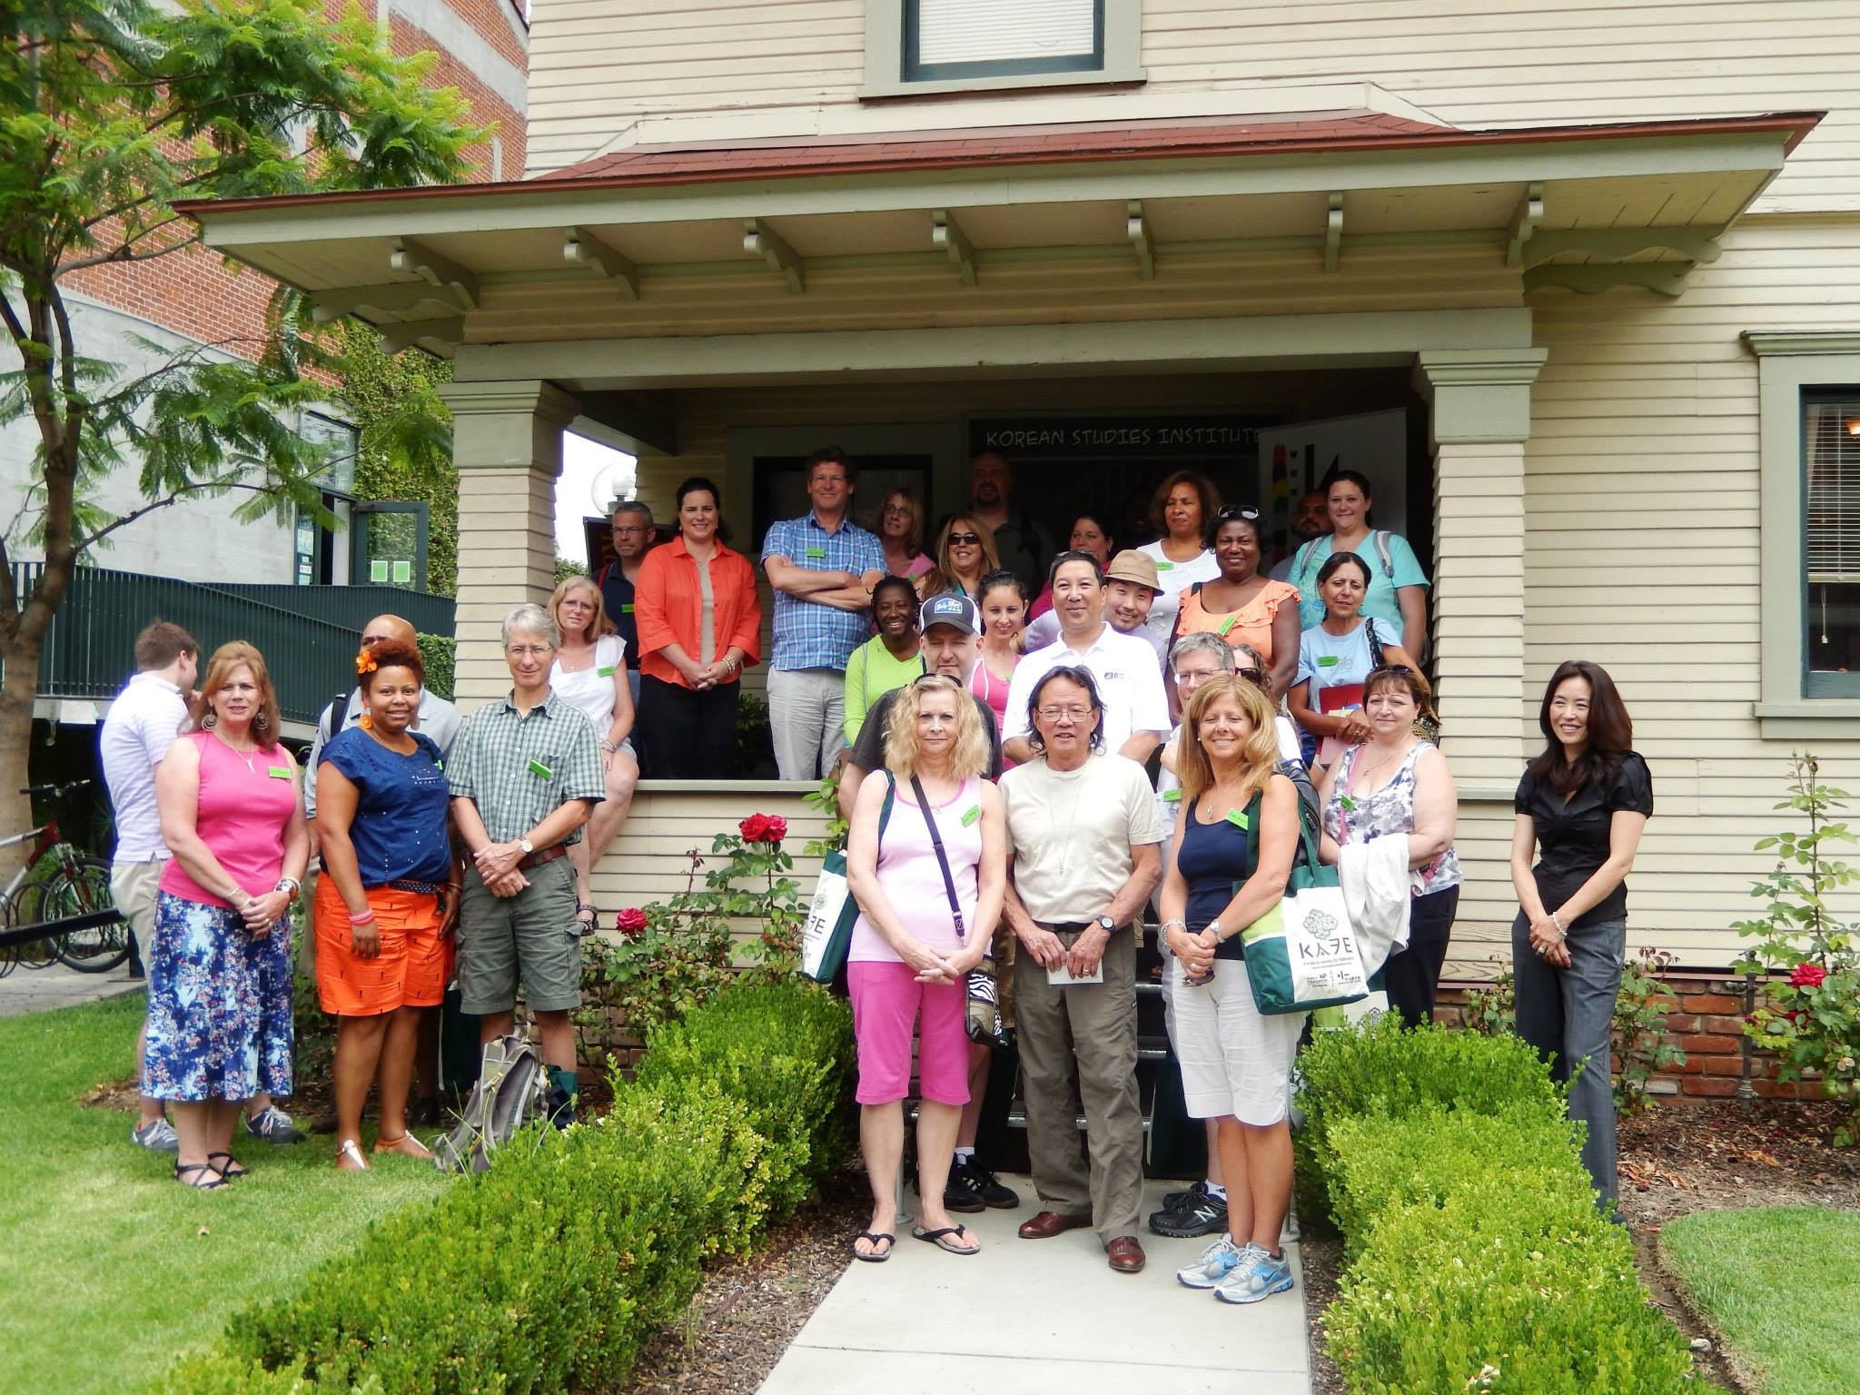

Slide 23
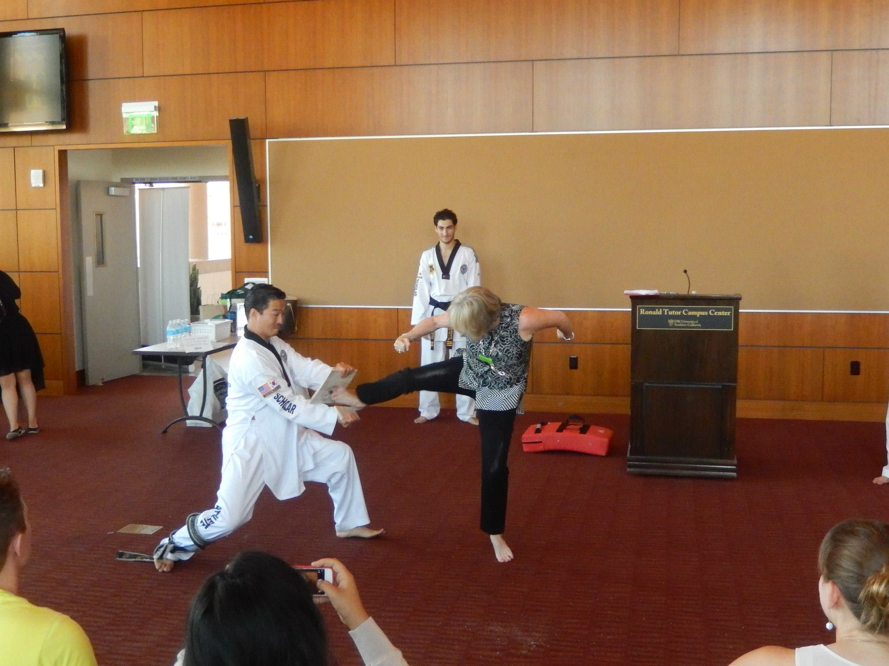

Slide 24
